Slide 1


CE-QUAL-W2 MODEL SETUP II Control File
UNCLASSIFIED
Todd Steissberg
U.S. Army Engineer Research and Development Center, Environmental Laboratory
CE-QUAL-W2 Workshop
July 08 - 09, 2024
Environmental Systems
Modeling Team
UNCLASSIFIED

Slide 2

What is the control file?
The control file is a central file that holds most model parameters.
Information is separated into cards. (Punch cards were originally used to input data into computers.)

Slide 3
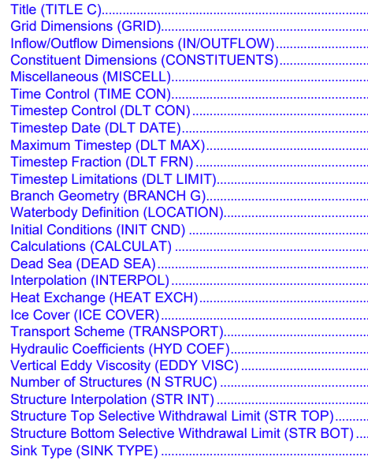
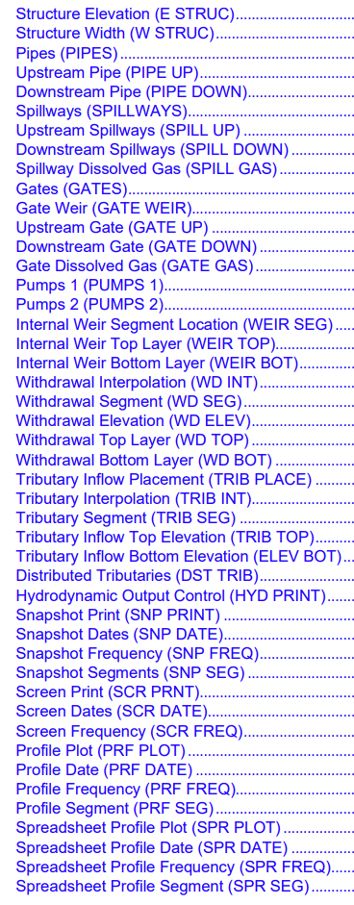
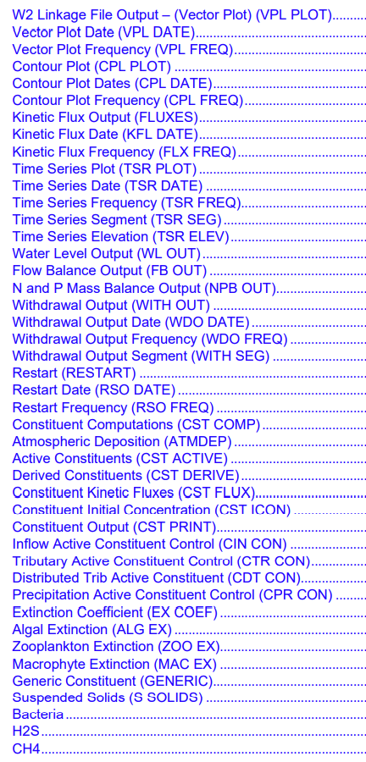
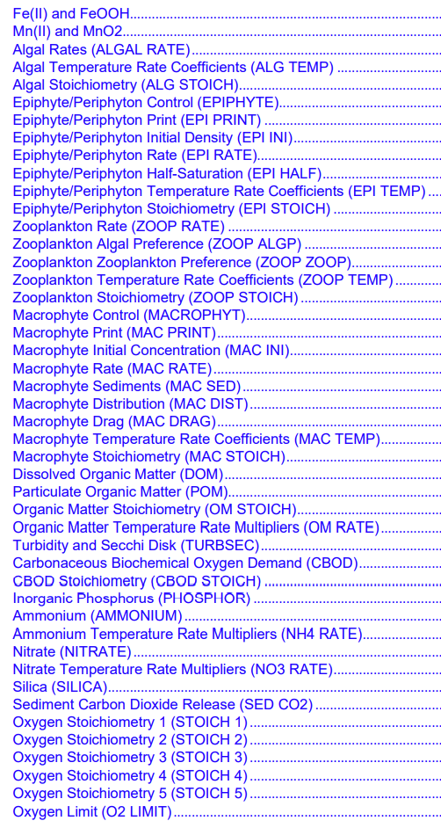
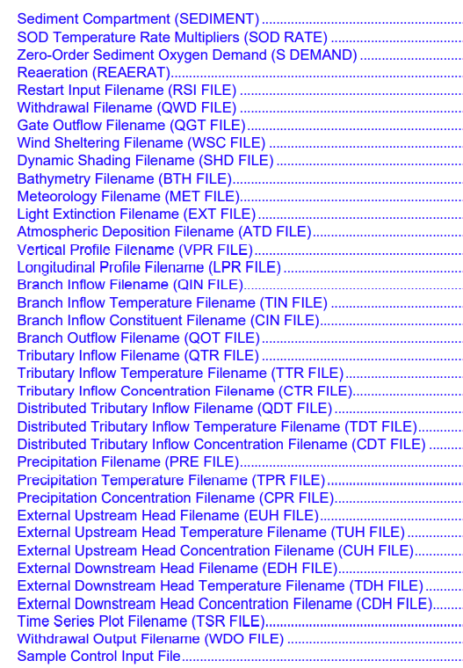
Cards: How they appear in the manual – 128 Cards

Slide 4
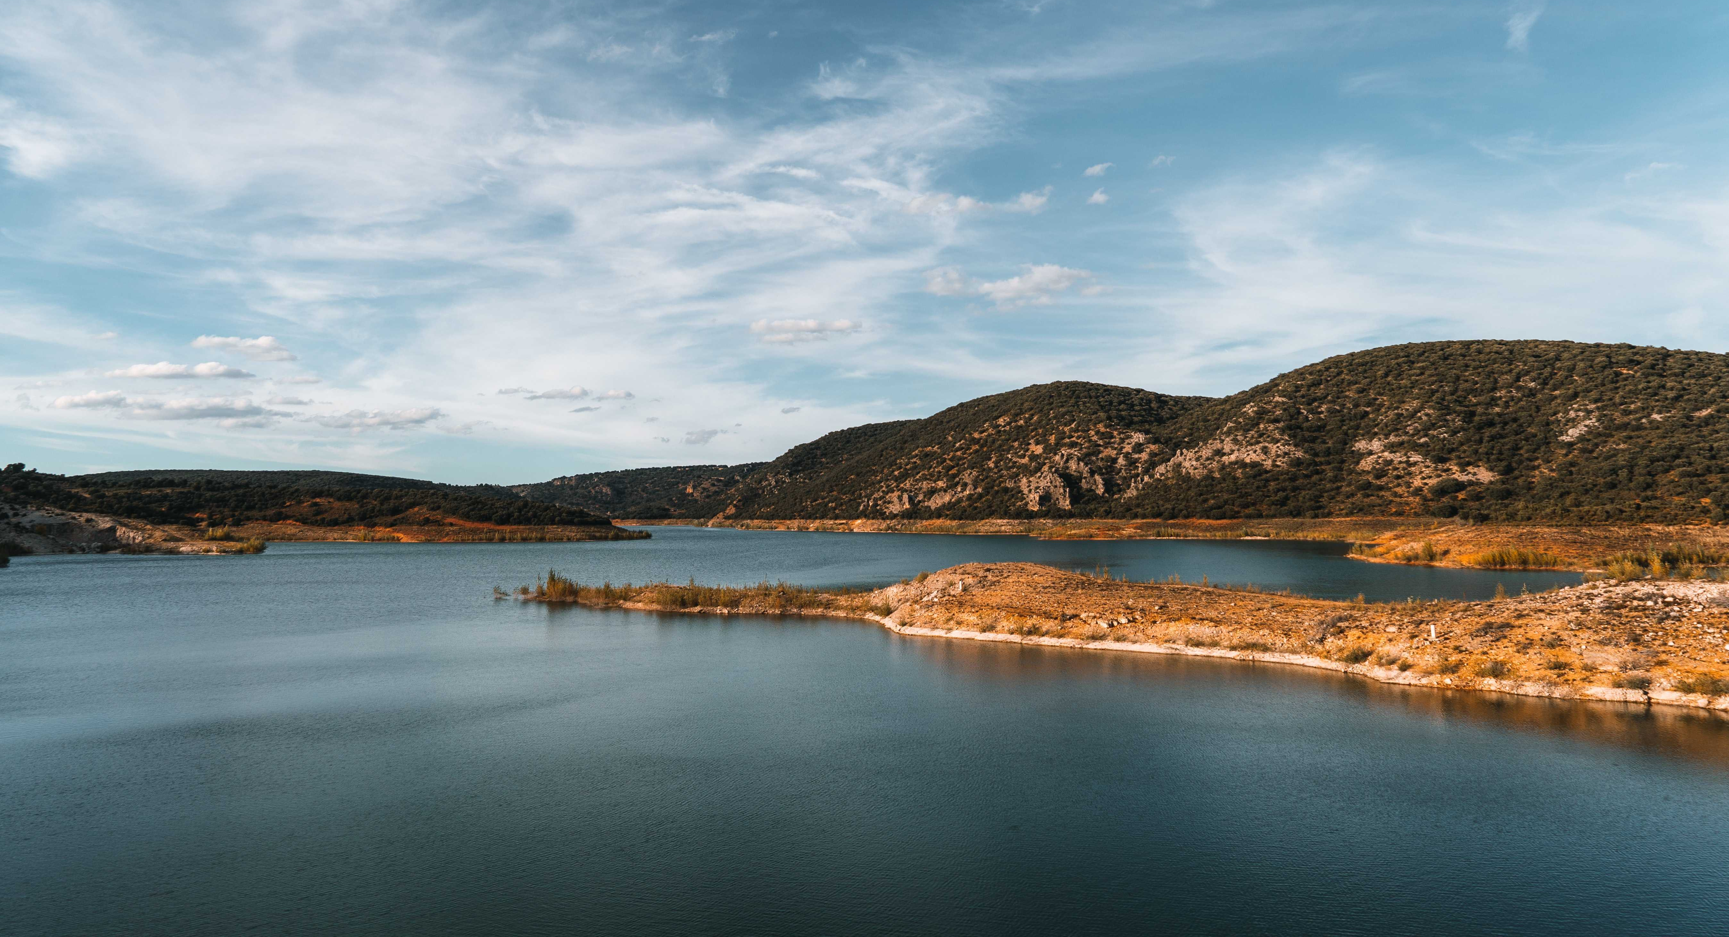
What kind of stuff does the control file contain?
Physical dimensions (GRID Card)
NWB – Number of waterbodies
NBR – Number of branches
IMX – Maximum number of segments
KMX – Maximum number of vertical layers
Physical features (INFLOW/OUTFLOW card)
NTR – Number of tributaries
NST – Number of structures
NIW – Number of internal weirs
NWD – Number of withdrawals
NGT – Number of gates
NSP – Number of spillways
NPI – Number of pipes
NPU – Number of pumps
What we are modeling? (CONSTITUENTS card)
NGC – Number of generic constituents
NSS – Number of suspended solids groups
NAL – Number of algal groups
NEP – Number of epiphyton groups
NBOD – Number of BOD groups
NMC – Number of macrophyte groups
NZP – Number of zooplankton groups
External References:
Include file names for input and output files
Meteorological input or timeseries output…
Have on/off switches for accessory modules
Fish habitat, sediment-diagenesis

Slide 5
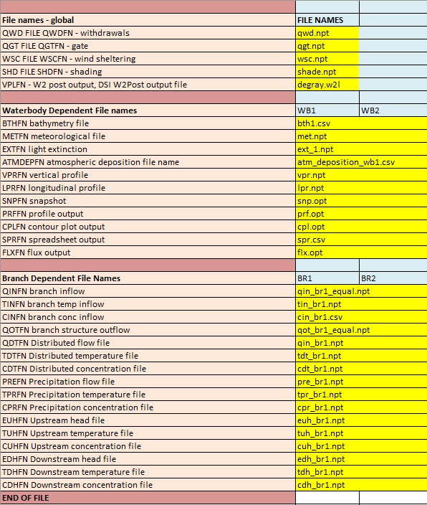
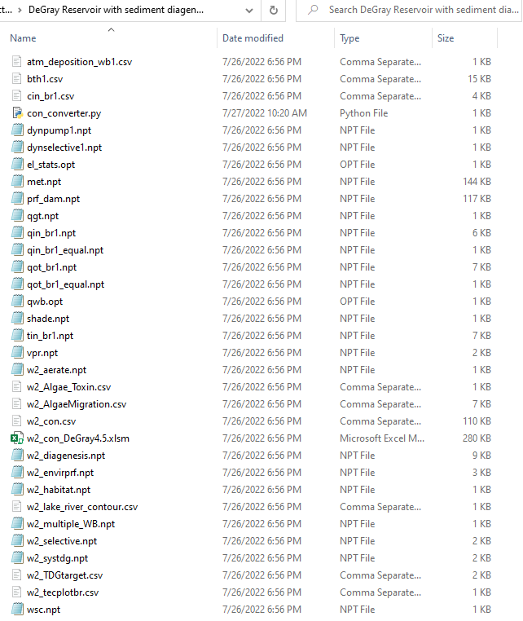
Time Series Inputs
Boundary conditions, meteorological inputs, etc.

Slide 6
Accessory Modules Controlled in w2_con
SELECTC suggests outlet controls based on water temperature
HABITATC calculates volume of fish habitat based on dissolved oxygen
ENVIRPC calculates amount of time and volume that reservoir meets certain conditions (i.e. constituent within certain range)
AERATEC allows user to add oxygen mass to simulate aerator
INITUWL calculates an initial velocity and normal depth for any non-zero slope waterbody
ORGCC controls whether carbon is used as the metric for organic matter constituents such as LDOM, RDOM, etc.
SED_DIAG controls flux of constituents and temperature between sediment and waterbody
AVERTM turns algal vertical migration on/off
w2_Algae_Toxin.csv – controlled by ON/OFF switch in ACTIVE CONSTITUENT card, ratio of toxin production for different algal types
atm_deposition_wb1.csv – controlled by ON/OFF switch in ACTIVE CONSTITUENT card, sets atmospheric mass input for various constituents
w2_tecplotbr.csv – controlled by ON/OFF switch in the CPL PLOT card, controls which branches to output

Slide 7
Accessory Modules Controlled by Presence in File Directory
w2_constriction.csv – specifies maximum width between segments, affects right-hand-side face – manual part 3, page 316
w2_particle.csv – specifies parameters to compute particle transport – manual part 3, page 456
w2_multiple_WB.npt – provides details for running simulations with multiple waterbodies – manual part 3, page 467
w2_systdg.npt – sets parameters for setting up total dissolved gas modeling – manual part 3, page 345
w2_TDGTarget.csv – sets spillway operation parameters that adjust based on TDG target – manual part 3, page 349
w2_lake_river_contour.csv – sets parameters for contour plots that vary over time – manual part 3, page 396

Slide 8
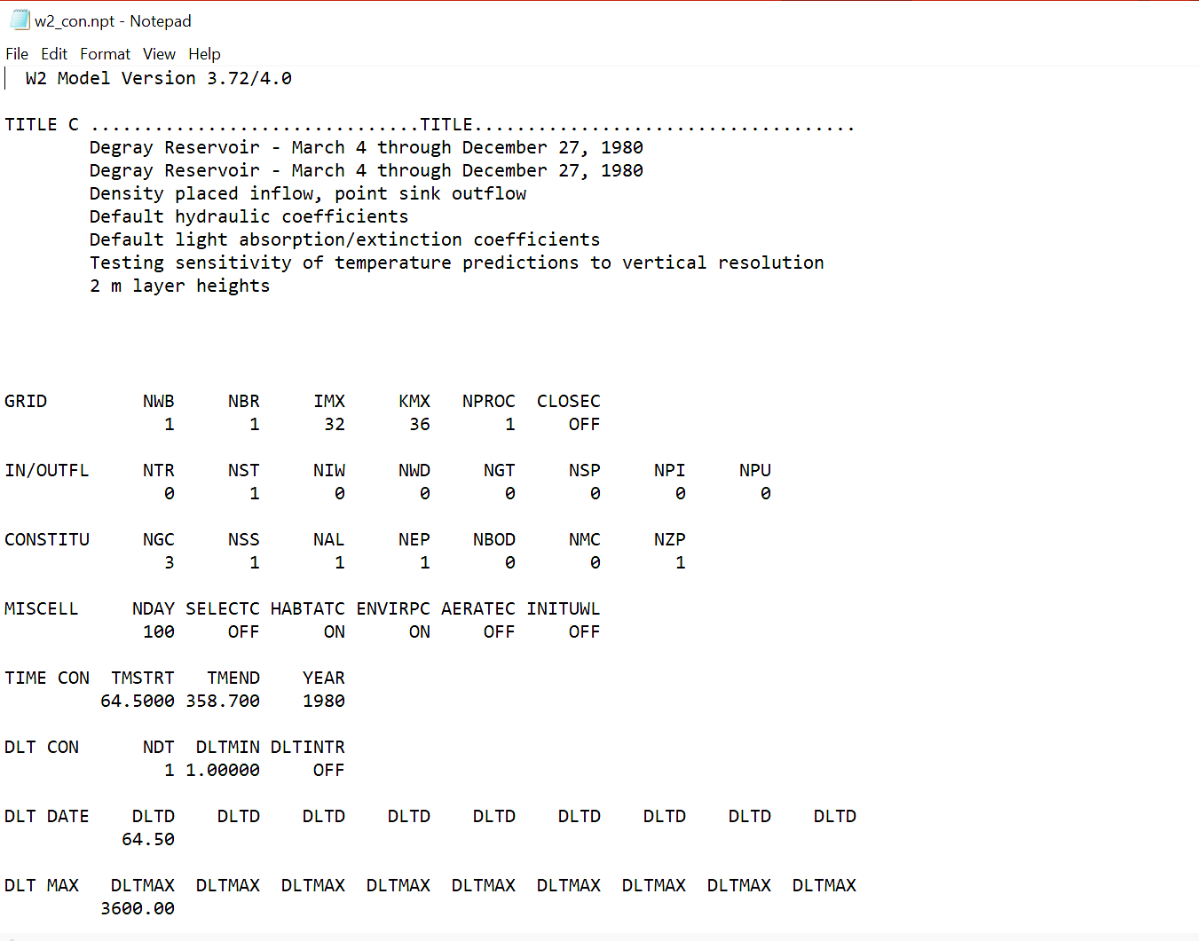
How does a control file look?
CE-QUAL-W2 Versions 3.7, 4.0, 4.1, and 4.2 all use .npt input files (ASCII files):

Slide 9
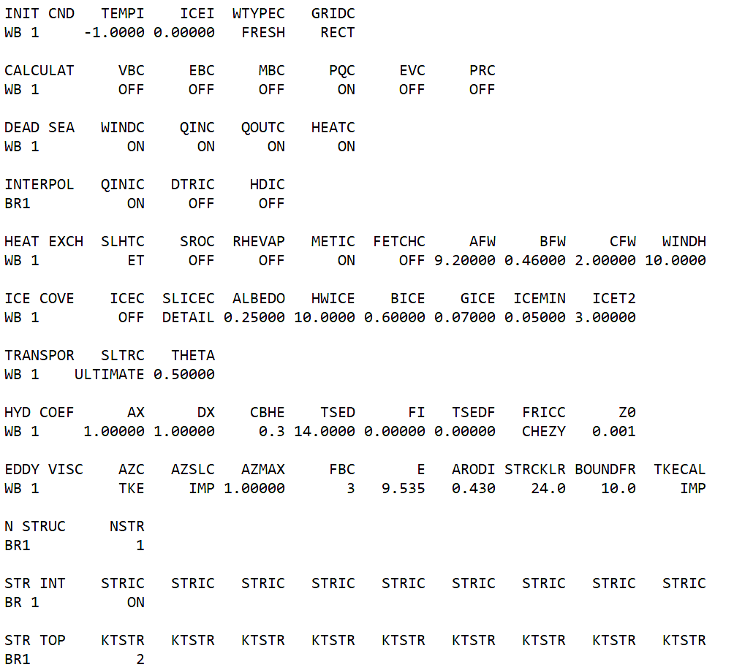
.npt file version
8-character width per entry

Slide 10
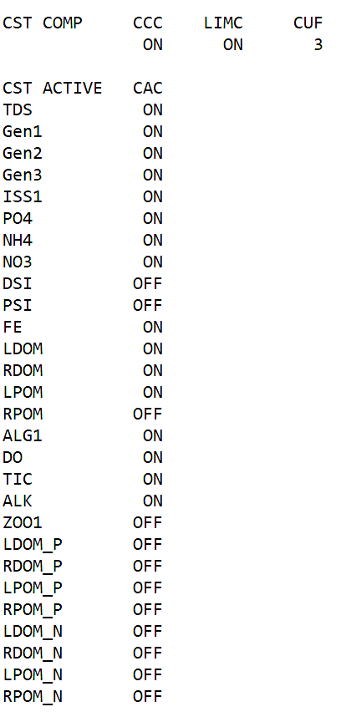
Fixed-Width (*.npt) File Version
Setting which WQ constituents are computed in the model

Slide 11
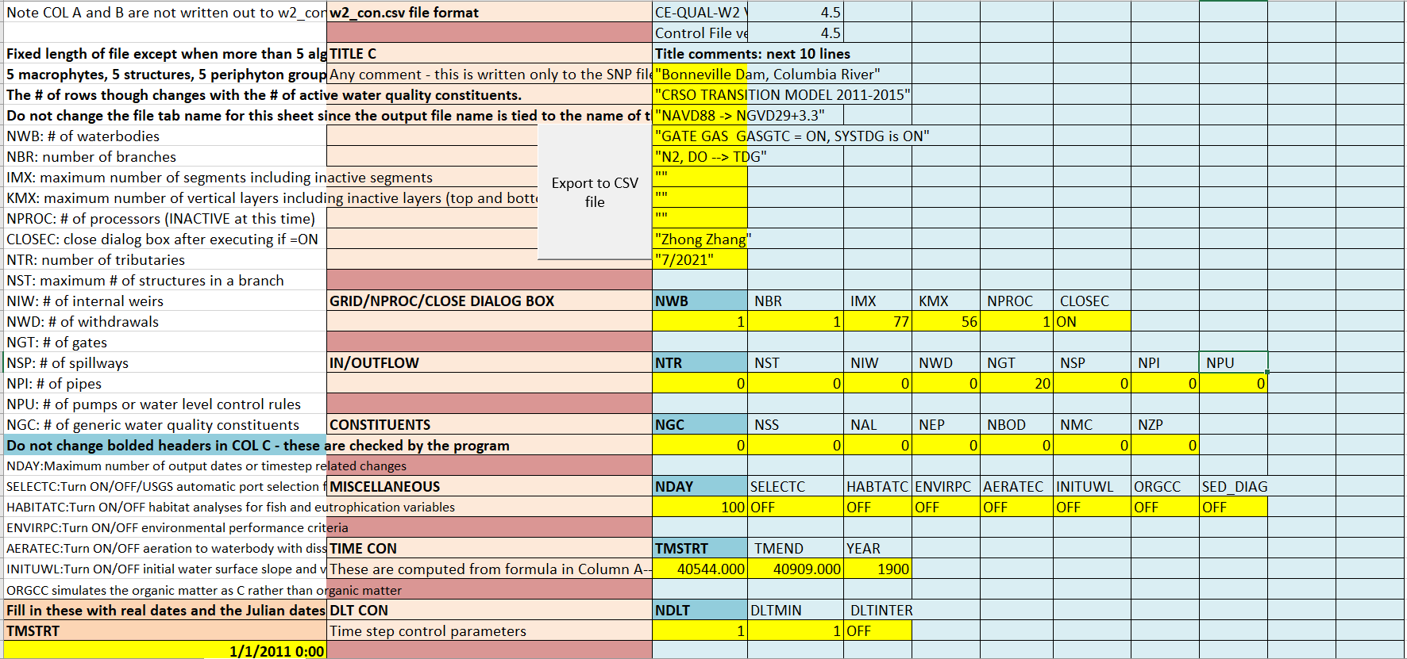
Version 5 User Interface
The most up-to-date user interface is an .xslm file (m stands for macro). The macro converts the excel into an .csv file which is readable by the model.

Slide 12
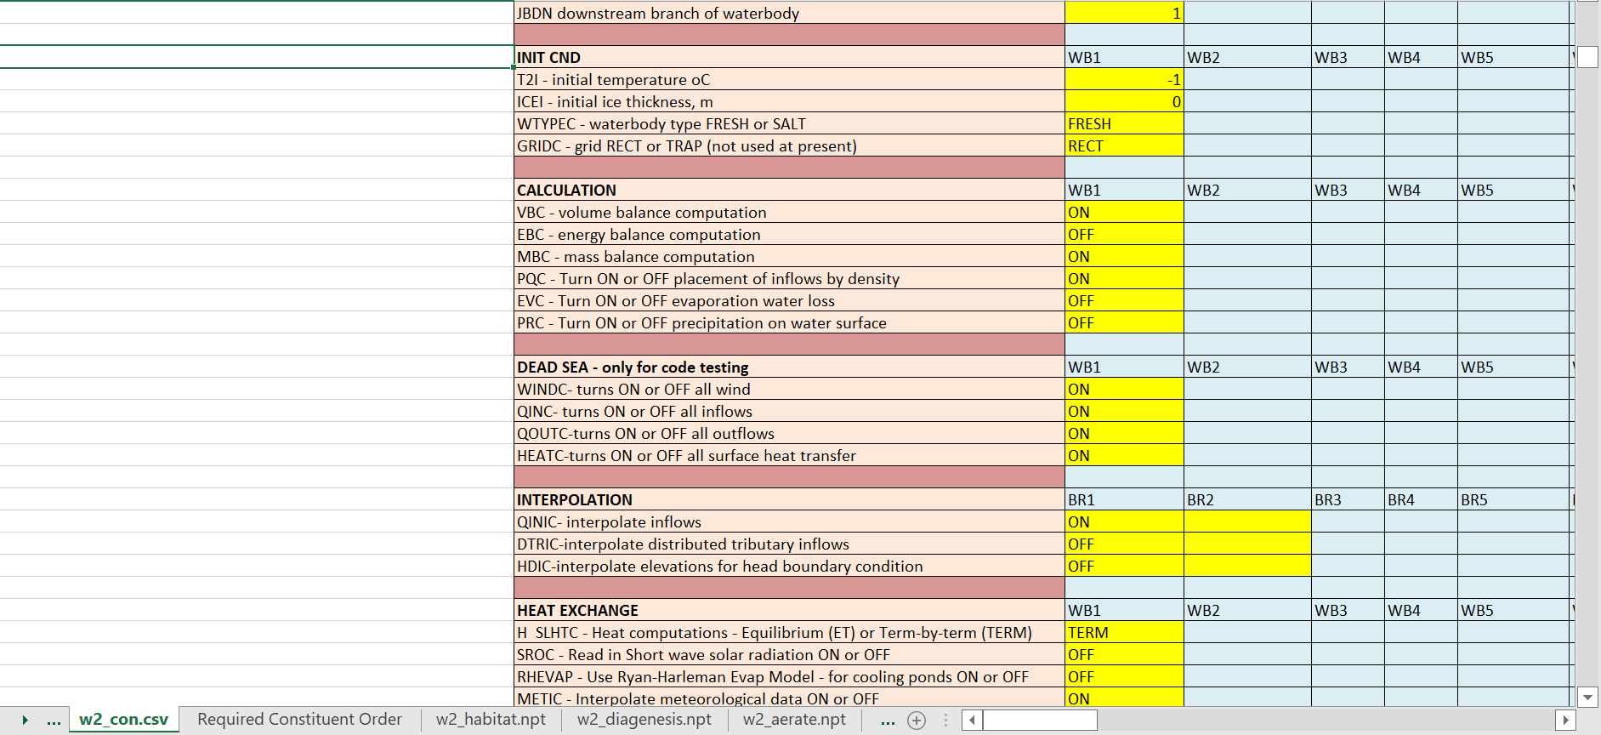
Version 5 User Interface
*.xlsm control file interface for the .csv control file
Orientation changed from .npt: Parameters now sorted by row; waterbody/branch by columns.

Slide 13
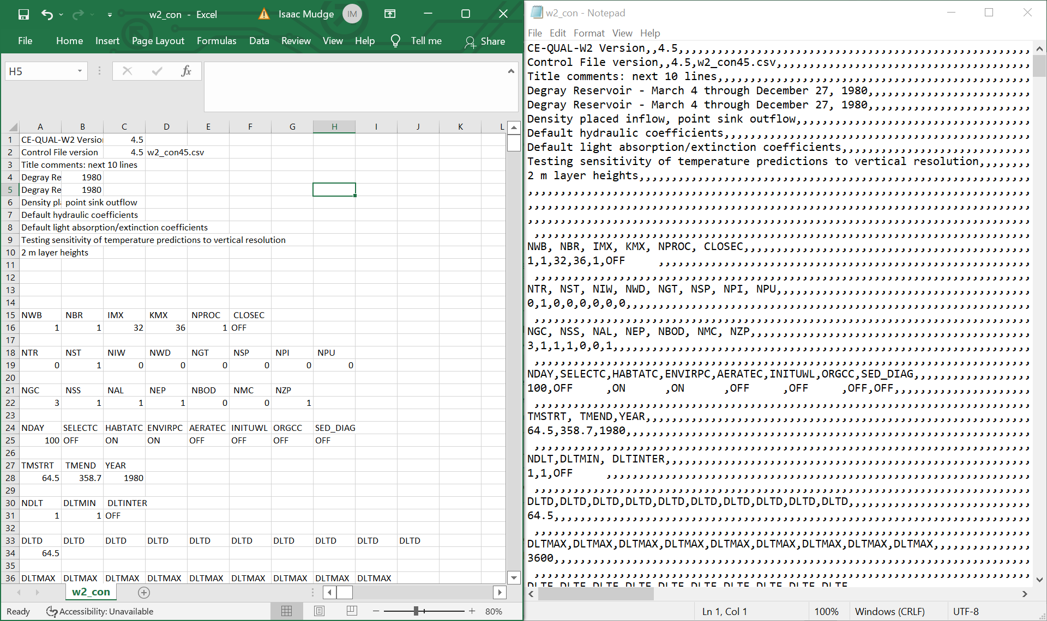
Version 5 User Interface
Both methods read the same .csv file, but notepad will show number of empty rows read in.

Slide 14
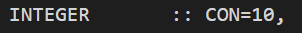
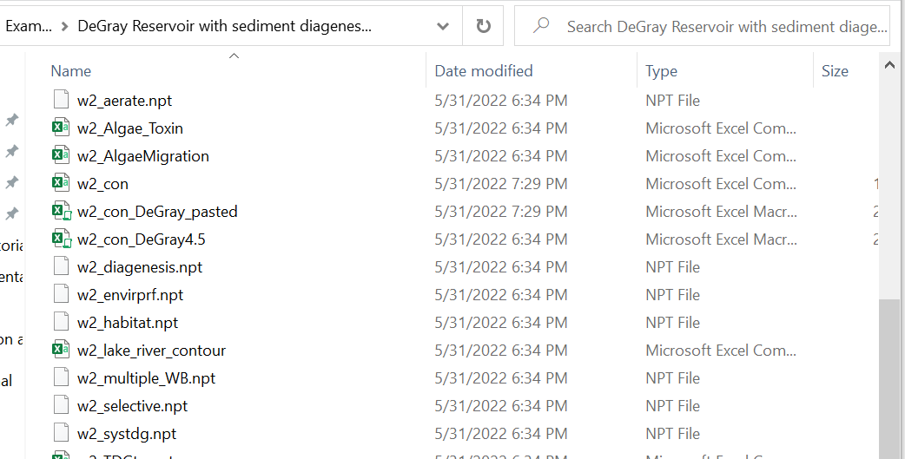
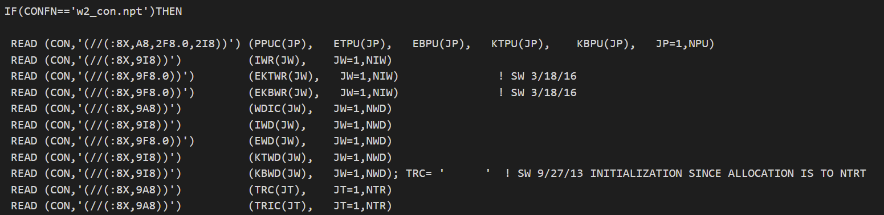
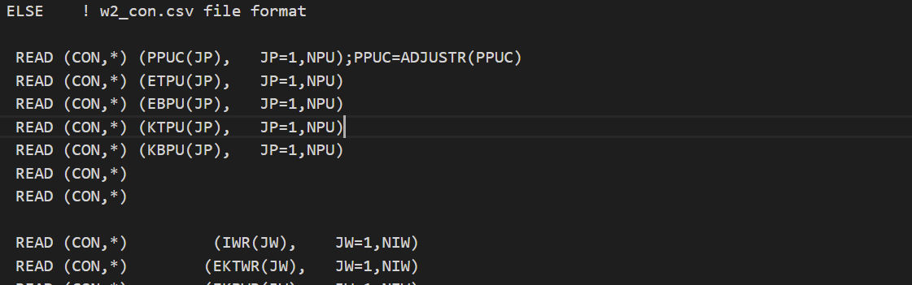
Version 5 User Interface
Fortran code: assigns CON a file number, checks the name of variable CONFN, and then reads in file number 10 in specific patterns based on whether in .npt or .csv file format.
File explorer: where all external file inputs live for a model, including the control file:

Slide 15
Cards: How they appear in the .xlsm – 80 Cards
1 | Grid Dimensions | 21 | Eddy Viscosity | 41 | Flow Balance Output | 61 | Algal Rates
2 | Inflow/Outflow Dimensions | 22 | Structures For Each Branch | 42 | N and P Mass Balance Output | 62 | Epiphyton
3 | Constituent Dimensions | 23 | Pipes | 43 | Iron Constituents Output | 63 | Epiphyton Rates
4 | Miscellaneous | 24 | Spillways | 44 | Restart | 64 | Zooplankton Rates
5 | Time Control | 25 | Gates | 45 | Constituent Computations | 65 | Macrophytes
6 | Timestep Control | 26 | Pumps | 46 | Atmospheric Deposition | 66 | Macrophyte Rates
7 | Timestep Date | 27 | Internal Weir | 47 | Concentration State Variables | 67 | Dissolved Organic Matter
8 | Maximum Timestep | 28 | Withdrawal | 48 | Derived Concentration State Variables | 68 | Particulate Organic Matter
9 | Timestep Fraction | 29 | Trib Placement | 49 | Concentration State Variables Flux | 69 | Organic Matter Stoichiometry
10 | Timestep Limitations | 30 | Distributed Trib | 50 | Extinction Coefficients | 70 | Turbidity
11 | Branch Grid | 31 | Hydraulic Print | 51 | Algal Extinction | 71 | CBOD
12 | Location | 32 | Snapshot Print | 52 | Zooplankton Extinction | 72 | Nutrients
13 | Initial Conditions | 33 | Screen Print | 53 | Macrophyte Extinction | 73 | Sediment CO2
14 | Calculation | 34 | Profile Output | 54 | Generic Constituent | 74 | Oxygen Limit
15 | Dead Sea | 35 | Spreadsheet Output | 55 | Suspended Solids | 75 | SOD Rates
16 | Interpolation | 36 | DSI W2Linkage | 56 | Bacteria | 76 | SOD Demand Zero Order
17 | Heat Exchange | 37 | Contour Plot Output | 57 | Hydrogen Sulfide | 77 | Reaeration
18 | Ice Cover | 38 | Fluxes | 58 | Methane | 78 | File Names – Global
19 | Transport Scheme | 39 | Timeseries Plot Output | 59 | Iron Constituents | 79 | Waterbody Dependent File Names
20 | Hydraulic Coefficients | 40 | Water Level Output | 60 | Manganese Constituents | 80 | Branch Dependent File Names

Slide 16

Grid Dimensions
Inflow/Outflow Dimensions
Constituent Dimensions
Miscellaneous
Time Control
Timestep Control
Timestep Date
Maximum Timestep
Timestep Fraction
Timestep Limitations
Branch Grid
Location
Initial Conditions
Calculation
Dead Sea
Interpolation
Heat Exchange
Ice Cover
Transport Scheme
Hydraulic Coefficients

Slide 17

Eddy Viscosity
Structures For Each Branch
Pipes
Spillways
Gates
Pumps
Internal Weir
Withdrawal
Trib Placement
Distributed Trib
Hydraulic Print
Snapshot Print
Screen Print
Profile Output
Spreadsheet Output
DSI W2Linkage
Contour Plot Output
Fluxes
Timeseries Plot Output
Water Level Output

Slide 18

Flow Balance Output
N and P Mass Balance Output
Iron Constituents Output
Restart
Constituent Computations
Atmospheric Deposition
Concentration State Variables
Derived Concentration State Variables
Concentration State Variables Flux
Extinction Coefficients
Algal Extinction
Zooplankton Extinction
Macrophyte Extinction
Generic Constituent
Suspended Solids
Bacteria
Hydrogen Sulfide
Methane
Iron Constituents
Manganese Constituents

Slide 19

Algal Rates
Epiphyton
Epiphyton Rates
Zooplankton Rates
Macrophytes
Macrophyte Rates
Dissolved Organic Matter
Particulate Organic Matter
Organic Matter Stoichiometry
Turbidity
CBOD
Nutrients
Sediment CO2
Oxygen Limit
SOD Rates
SOD Demand Zero Order
Reaeration
File Names – Global
Waterbody Dependent File Names
Branch Dependent File Names

Slide 20

Grid Dimensions
Inflow/Outflow Dimensions
Constituent Dimensions
Miscellaneous
Time Control
Timestep Control
Timestep Date
Maximum Timestep
Timestep Fraction
Timestep Limitations
Branch Grid
Location
Initial Conditions
Calculation
Dead Sea
Interpolation
Heat Exchange
Ice Cover
Transport Scheme
Hydraulic Coefficients

Slide 21

Eddy Viscosity
Structures For Each Branch
Pipes
Spillways
Gates
Pumps
Internal Weir
Withdrawal
Trib Placement
Distributed Trib
Hydraulic Print
Snapshot Print
Screen Print
Profile Output
Spreadsheet Output
DSI W2Linkage
Contour Plot Output
Fluxes
Timeseries Plot Output
Water Level Output

Slide 22

Flow Balance Output
N and P Mass Balance Output
Iron Constituents Output
Restart
Constituent Computations
Atmospheric Deposition
Concentration State Variables
Derived Concentration State Variables
Concentration State Variables Flux
Extinction Coefficients
Algal Extinction
Zooplankton Extinction
Macrophyte Extinction
Generic Constituent
Suspended Solids
Bacteria
Hydrogen Sulfide
Methane
Iron Constituents
Manganese Constituents

Slide 23

Algal Rates
Epiphyton
Epiphyton Rates
Zooplankton Rates
Macrophytes
Macrophyte Rates
Dissolved Organic Matter
Particulate Organic Matter
Organic Matter Stoichiometry
Turbidity
CBOD
Nutrients
Sediment CO2
Oxygen Limit
SOD Rates
SOD Demand Zero Order
Reaeration
File Names – Global
Waterbody Dependent File Names
Branch Dependent File Names

Slide 24

Grid Dimensions
Inflow/Outflow Dimensions
Constituent Dimensions
Miscellaneous
Time Control
Timestep Control
Timestep Date
Maximum Timestep
Timestep Fraction
Timestep Limitations
Branch Grid
Location
Initial Conditions
Calculation
Dead Sea
Interpolation
Heat Exchange
Ice Cover
Transport Scheme
Hydraulic Coefficients

Slide 25

Eddy Viscosity
Structures For Each Branch
Pipes
Spillways
Gates
Pumps
Internal Weir
Withdrawal
Trib Placement
Distributed Trib
Hydraulic Print
Snapshot Print
Screen Print
Profile Output
Spreadsheet Output
DSI W2Linkage
Contour Plot Output
Fluxes
Timeseries Plot Output
Water Level Output

Slide 26

Flow Balance Output
N and P Mass Balance Output
Iron Constituents Output
Restart
Constituent Computations
Atmospheric Deposition
Concentration State Variables
Derived Concentration State Variables
Concentration State Variables Flux
Extinction Coefficients
Algal Extinction
Zooplankton Extinction
Macrophyte Extinction
Generic Constituent
Suspended Solids
Bacteria
Hydrogen Sulfide
Methane
Iron Constituents
Manganese Constituents

Slide 27

Algal Rates
Epiphyton
Epiphyton Rates
Zooplankton Rates
Macrophytes
Macrophyte Rates
Dissolved Organic Matter
Particulate Organic Matter
Organic Matter Stoichiometry
Turbidity
CBOD
Nutrients
Sediment CO2
Oxygen Limit
SOD Rates
SOD Demand Zero Order
Reaeration
File Names – Global
Waterbody Dependent File Names
Branch Dependent File Names

Slide 28

Grid Dimensions
Inflow/Outflow Dimensions
Constituent Dimensions
Miscellaneous
Time Control
Timestep Control
Timestep Date
Maximum Timestep
Timestep Fraction
Timestep Limitations
Branch Grid
Location
Initial Conditions
Calculation
Dead Sea
Interpolation
Heat Exchange
Ice Cover
Transport Scheme
Hydraulic Coefficients

Slide 29

Eddy Viscosity
Structures For Each Branch
Pipes
Spillways
Gates
Pumps
Internal Weir
Withdrawal
Trib Placement
Distributed Trib
Hydraulic Print
Snapshot Print
Screen Print
Profile Output
Spreadsheet Output
DSI W2Linkage
Contour Plot Output
Fluxes
Timeseries Plot Output
Water Level Output

Slide 30

Flow Balance Output
N and P Mass Balance Output
Iron Constituents Output
Restart
Constituent Computations
Atmospheric Deposition
Concentration State Variables
Derived Concentration State Variables
Concentration State Variables Flux
Extinction Coefficients
Algal Extinction
Zooplankton Extinction
Macrophyte Extinction
Generic Constituent
Suspended Solids
Bacteria
Hydrogen Sulfide
Methane
Iron Constituents
Manganese Constituents

Slide 31

Algal Rates
Epiphyton
Epiphyton Rates
Zooplankton Rates
Macrophytes
Macrophyte Rates
Dissolved Organic Matter
Particulate Organic Matter
Organic Matter Stoichiometry
Turbidity
CBOD
Nutrients
Sediment CO2
Oxygen Limit
SOD Rates
SOD Demand Zero Order
Reaeration
File Names – Global
Waterbody Dependent File Names
Branch Dependent File Names

Slide 32

Model Setup: Control File - Questions?

